Slide 1
Mechanism Design Basics: Starting From Auction
Prepared and Presented by
Zeng Yuxiang
based on the slides provided by
Prof. Tang Pingzhong

Slide 2

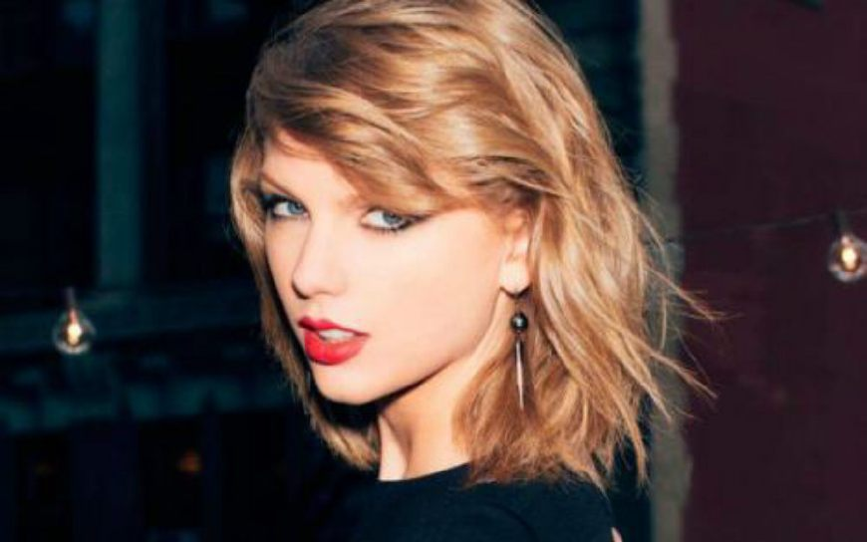

The oldest auction?
500BC: Babylon auctions of women for marriage
Notes:
回顾一下拍卖的历史

Slide 3
Fun facts of Babylon marriage auction
Two groups
Group 1: Men pay women for marriage
Group 2: Women pay men for marriage
Order of auction
In descending order of beauty
Beauty is in the eye of the auctioneer
No outside option
Illegal to get married via any other means
Get-along phase
In case of mutual rejection --- refund and re-auction

Slide 4

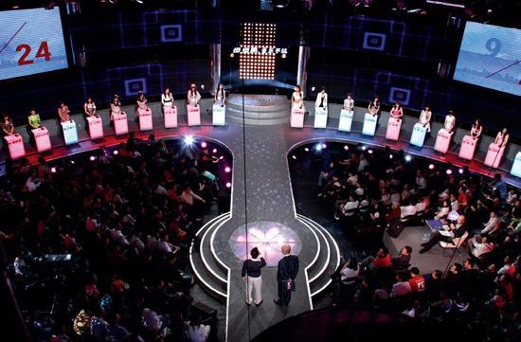
Babylon marriage auction In Realistic

Slide 5



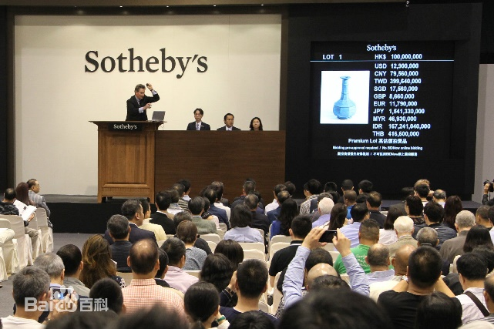
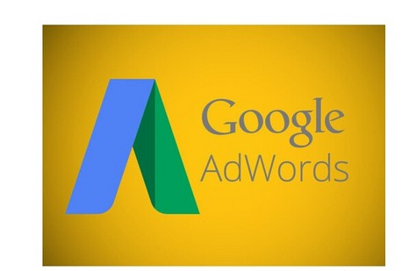

Other Auction Applications
直接应用
Notes:
京东，阿里，这种电商的拍卖，包括ebay
第二类是传统的拍卖行
第三类是广告竞拍
现在还有二手车的销售方式

Slide 6
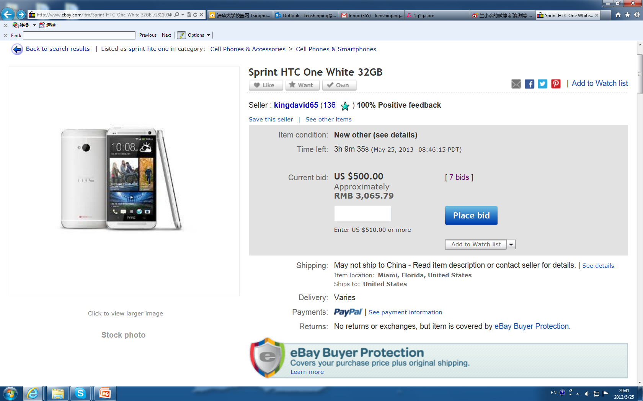
An eBay Auction

Slide 7
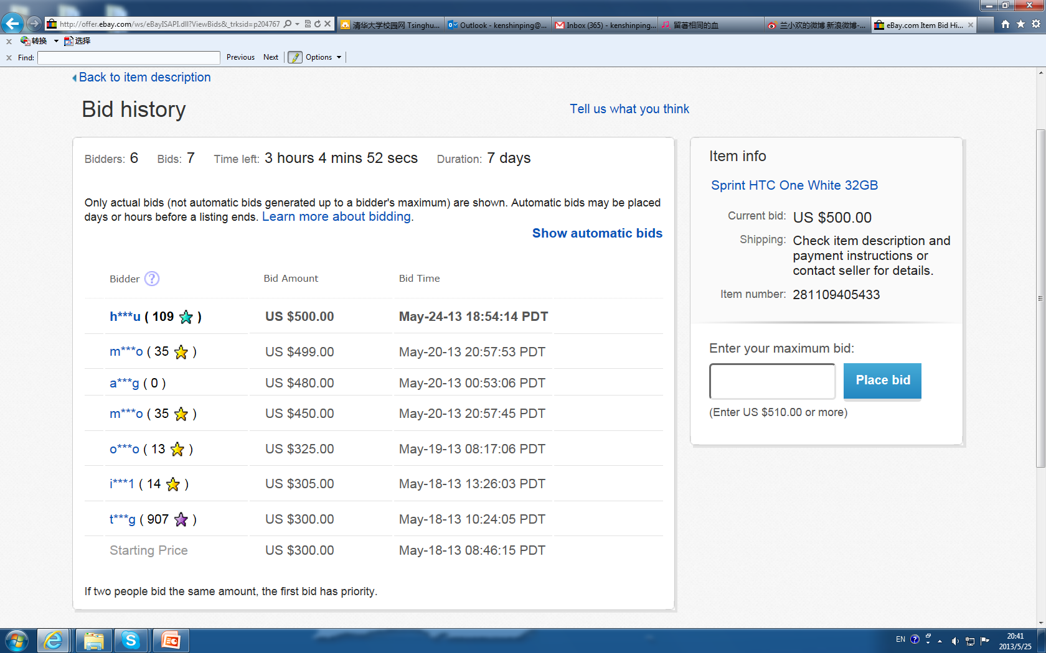
A Closer Look

Slide 8
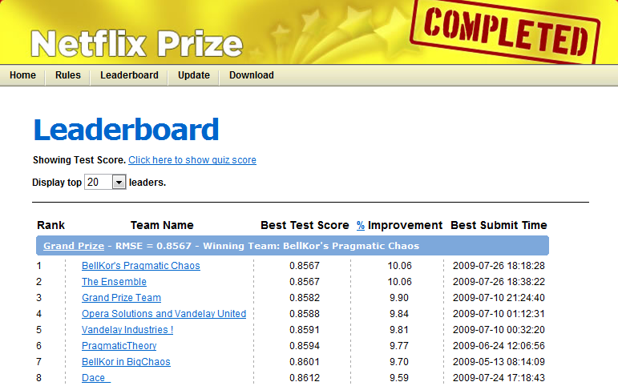

Crowd sourcing ≈ all-pay auction Nokia ringtone and Netflix prize
IJCAI competition on predicting repeated buyers in Taobao

Slide 9




Sponsored Search: Selling Advertisement

Slide 10
What is Auction?
Explanation:
Methods for allocating goods, tasks and resources
Participants: one seller, at least one bidder/buyer
Agreement between seller and bidders
Who gets the good/item?
How much does everyone pay?
Reverse auction: one buyer, multiple sellers
Auction is a direct quasi-linear mechanism
(1) direct mechanism: Orange Book Section 14;
(2) quasi-linear: Orange Book Section 18.1
Notes:
拍卖是物品、任务、资源分配的一种方式
拍卖的参与者：一个卖家，至少一个买家。
拍卖这种行为，其实是卖家和买家之间达成共识，什么共识呢？
两个问题：1）哪个买家得到最终的货物；2）这个买家应该支付多少钱。
这里稍微提一句，反向拍卖的场景：一个买家，多个卖家。
拍卖是一种典型的、拟线性的直接机制。
这里面拟线性的概念，我也不是很清楚。我理解是utility函数是拟线性的。

Slide 11
Classification
Selling a single item
Sell an Hermes handbag
Selling multiple identical items
Google advertising
Wheat
Selling multiple distinct items
Wireless spectrum
Airport departure/landing slots
Notes:
拍卖可以有多种分类，这里我介绍唐平忠的一种。
很容易理解，他把拍卖分成：一件商品的拍卖，多个相同商品的拍卖，和多个不同商品的拍卖。

Slide 12
Single-item auctions
Notes:
这一节，主要是从单一商品的拍卖开始讲起，内容很简单。

Slide 13
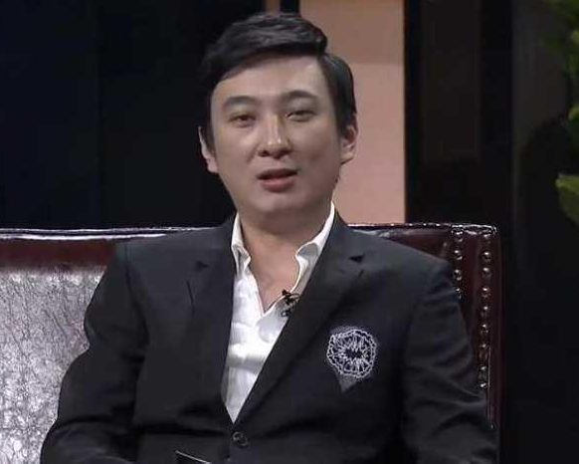
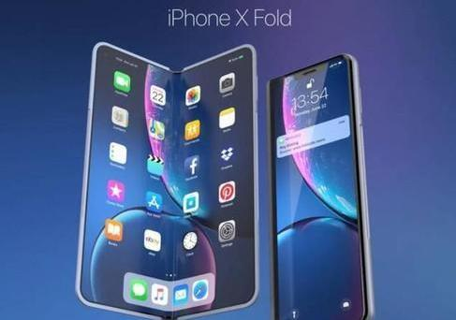

Single-item Auction: Example
Consider a seller that had an old smartphone.
He wants to sell the phone on eBay Auction.
Notes:
什么是单一商品的拍卖呢，举一个最简单的例子，你有一部旧手机想要放到ebay上面来卖。

Slide 14
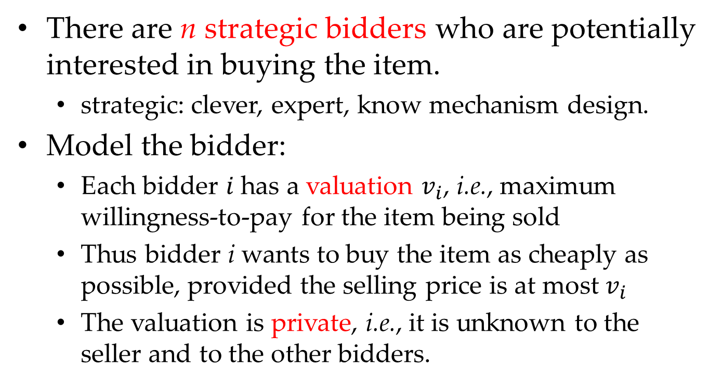
Single-item Auction: Definition
There are n strategic bidders who are potentially interested in buying the item.
strategic: clever, expert, know mechanism design.
Model the bidder:
Each bidder $i$ has a valuation $v_{i}$, i.e., maximum willingness-to-pay for the item being sold
Thus bidder i wants to buy the item as cheaply as possible, provided the selling price is at most $v_{i}$
The valuation is private, i.e., it is unknown to the seller and to the other bidders.
Notes:
它的基本问题定义是这样的：有n个聪明的bidder，并且呢这n个人潜在地对购买一个商品感兴趣。
这里面，我把strategic这个词翻译成了聪明。可以理解成，每个bidder都是聪明的，机制设计的专家。
因此，在实战中，这些bidder往往可以操控一些不合理的机制，凭借他们的专业知识。
其实，这里本质上是在假设最坏情况。
同时，对于bidder。每个bidder都有一个心里预期，即为了购买这个商品，他最多能够支付多少钱。
很显然，每个bidder都希望能够以最便宜的价格购买到这个商品，并且他最多能够支付v_i元钱。
这个心理预期的定义非常经典和常用，因为他是bidder内心的想法，显然没有哪个bidder会公开自己的心理预期，因此，通常我们都假设心里预期对于卖家和其它买家不可见。

Slide 15
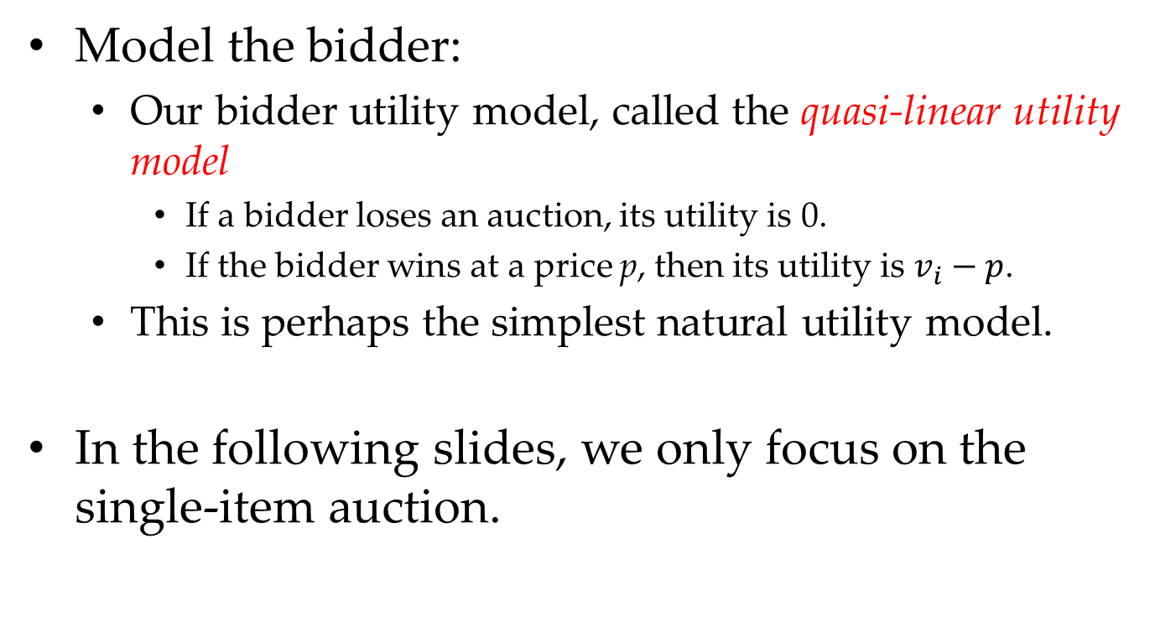
Single-item Auction: Definition
Model the bidder:
Our bidder utility model, called the quasi-linear utility model
If a bidder loses an auction, its utility is 0.
If the bidder wins at a price p, then its utility is $v_{i}−p$.
This is perhaps the simplest natural utility model.
In the following slides, we only focus on the single-item auction.
Notes:
接下来，我们还需要定义这一类问题中的utility函数。这里，我们采用拟线性utility model。
具体什么意思呢，很简单？
如果一个bidder最终没能拍到这个商品，它的utility为0；反之，如果一个bidder以价格p获得了这个商品，它的utility为价格v_i-p。
显然，对于获胜的bidder，它是希望utility越大越好的，因为这意味着他剩下的钱会越多，花的钱越少。

Slide 16
A Widely Used Assumption: Independent Private Value (IPV)
Each buyer i has a private valuation v_{i} towards the item
Maximum amount of money i is willing to pay
v_{i} represents buyer’s type, lose generality?
v_{i} is drawn from a publicly known distribution F
Only buyer i knows the realization of v_{i}
Others, including the seller, know F only
Valuations are I.I.D
Technical assumptions on CDF F
[0,v_{max}]
Admits a continuous density function, full support
[1] Tong Yongxin and Wang Libin et al. Dynamic Pricing in Spatial Crowdsourcing: A Matching-Based Approach, In SIGMOD’18.
Notes:
有个常用的假设，叫做IPV。它就是基于心里预期的。
因为IPV非常常用，所以这里我稍微扩展一下。
首先，以拍卖为例：每个买家都对这个商品有个心里预期，因为我们使用这个心理预期的值来表示买家类型。
后续，在陆续很多AAMAS/AAAI的论文里，你们会发现，type/profile这种词经常被提及。通常，我们采用一些可量化的变量来model买家或卖家的一些属性。
这里，我们假设心里预期服从某个已知的分布F，注意，这里假设分布式已知。
但是，每个人的心里预期仍然是私密的，即具体的数值是位置的。
同时，我们假设这些未知的数值一定满足独立同分布。尽管独立同分布这个假设有的时候不那么符合现实情况，但是这也是常用的假设质疑。
最后，我们假设对累计概率分布函数是在给定范围内的，即从0到vmax，并且是连续概念密度函数。
最典型的例子是童老师和立斌co-aothor的sigmod’18.

Slide 17
Sealed-Bid Auctions
Notes:
说完了，拍卖的定义，我们还是回到拍卖。这里，我们主要讲密封拍卖。它的定义很简单。举个例子。。。。

Slide 18
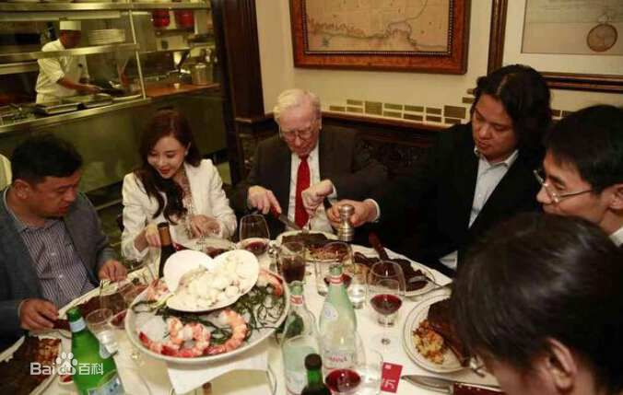
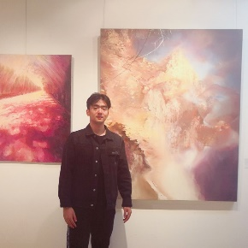
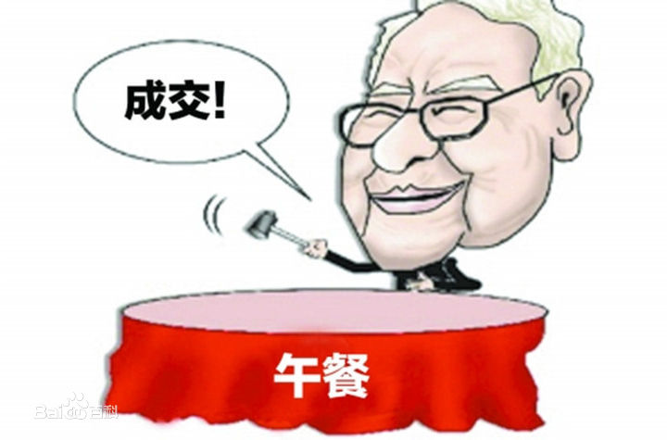
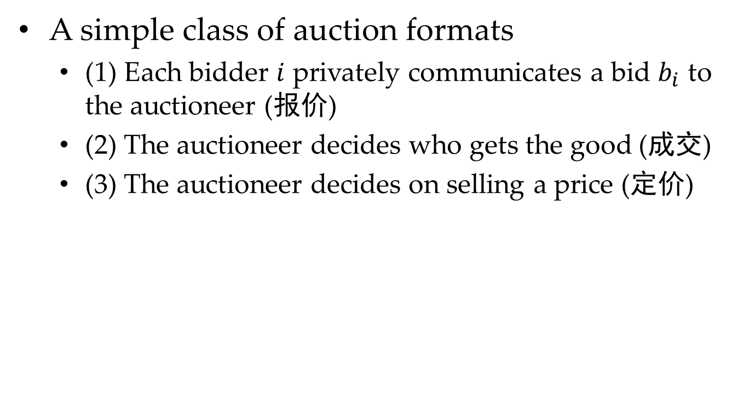
Sealed-Bid Auction
A simple class of auction formats
(1) Each bidder $i$ privately communicates a bid $b_{i}$ to the auctioneer (报价)
(2) The auctioneer decides who gets the good (成交)
(3) The auctioneer decides on selling a price (定价)
Notes:
因此，密封拍卖可以拆分成三个步骤：
第一步是报价，即每个bidder把他的bid结果私密地提交给拍卖家；
第二步是成交，即卖家决定商品的最终归属；
第三部是定价，即卖家决定商品的最终成交价格。
我们可以现场来模拟这个例子，比如前几年巴菲特午餐特别火。
这就是个典型的拍卖的例子，这里我们竞拍一下李一鸣午餐。

Slide 19
Sealed-Bid Auction
In step (2): we assume to select the bidder with the highest bid
In step (3): there are many strategies:
Zero-Price Auction
First-Price Auction
Second-Price Auction
Notes:
言归正传，前面我们提到了拍卖主要由三步组成：报价、成交和定价。
因此，在成交阶段，卖家通常是希望能够将商品卖给报价最高的买家，这样赚的钱尽可能多。
在定价阶段，有很多常用的策略。
这里我们介绍三种，零元拍卖、第一价格拍卖，和第二价格拍卖。
其中，零元价格拍卖不是一个学术的专有名词，是我窜出来的一个词。

Slide 20

Zero-Price Auction
Auctioneer charges the winning bidder nothing.
Thus, in order to get the item, everyone starts to bid with the higher number.
Eventually, the auction becomes a game, “who can name the highest number?”
Notes:
零元拍卖，最容易理解。就是卖家决定这个商品只需要支付0元。
因此，bid价格最高的买家可以不花任何钱买到这个商品。
很显然，一个最优策略就是尽可能的写最大的数字。

Slide 21
First-Price Auction
Notes:
相比于零元报价，第一价格和第二价格策略都很常用，而且吸引了很多researcher投入了大量精力去研究。
也是我们这次讨论的重点。

Slide 22
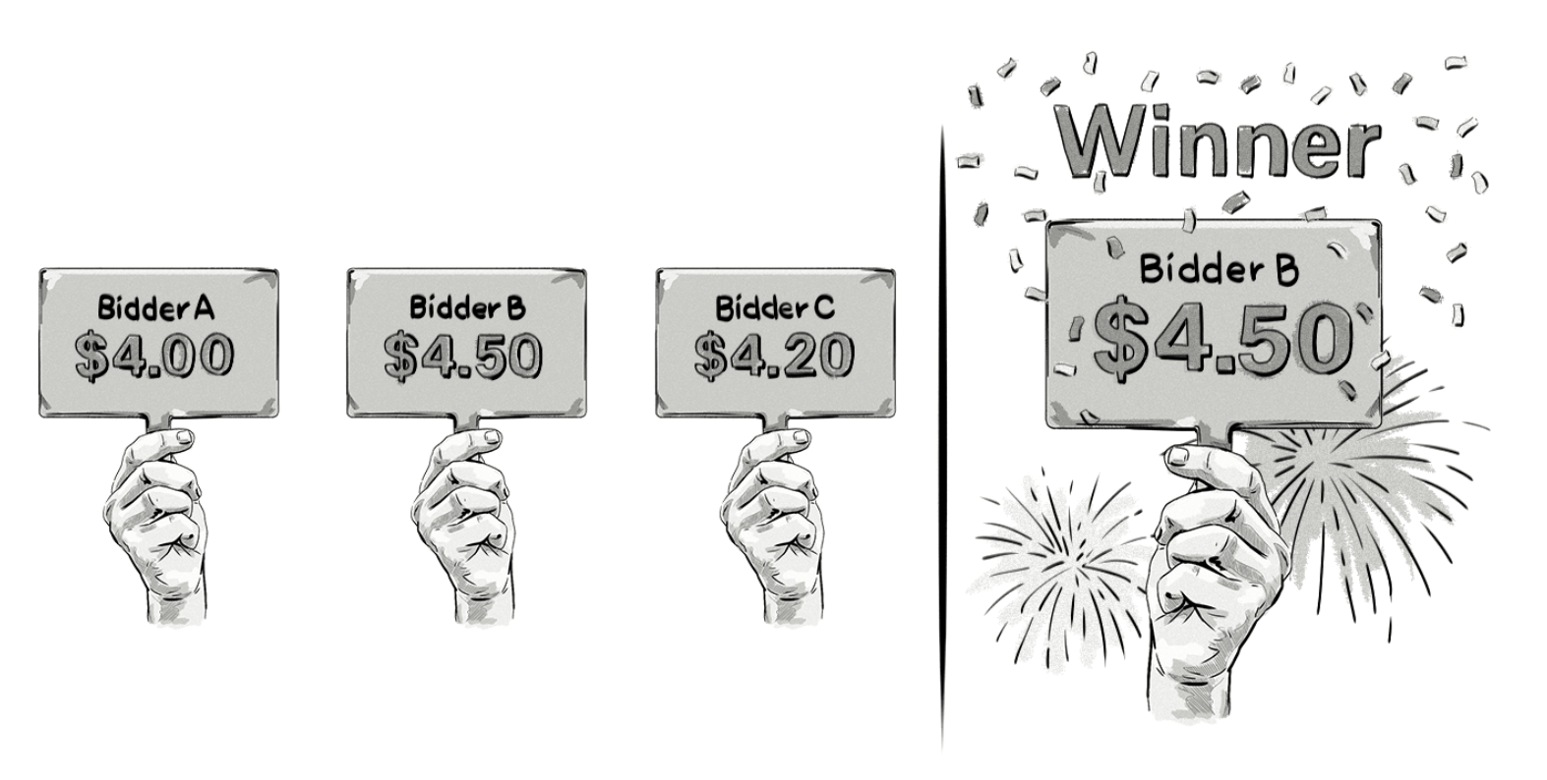
First-Price Auction
Definition: let the winning bidder pay his bid
Notes:
第一价格拍卖的定义很好理解，就是你报价多少，你支付多少。
这里有个简单的例子，显然报价最高的是B，因此他需要支付他所报的价格。

Slide 23
First-Price Auction
Disadvantages：
As a bidder, it is hard to figure out how to bid.
As a seller or auction designer, it is hard to predict what will happen.
Applications:
Sponsored search: it was first used in Yahoo!, Google, and MSN in 1997.
Notes:
第一价格定价的缺陷主要包括两方面：
1）作为卖家，很难决定我要怎么报价，比如，我就想买下某个商品，我该怎么制定报价策略
2）作为卖家，很难预计到我的商品最终会卖多少钱，会亏还是赚
尽管看起来第一价格定价很trivial，很直接，它的应用其实还很广泛：
1）比如，在2000年，第一价格定价就被应用到Yahoo, Google等公司的广告业务中。

Slide 24
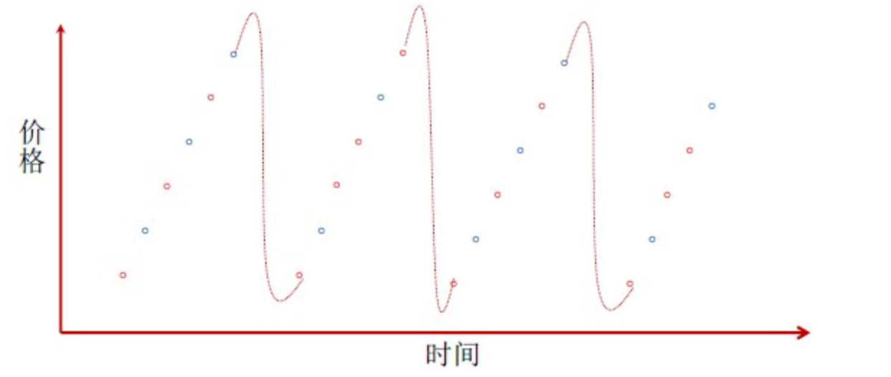
First-Price Auction: A Case Study
Strategic bidder的微小差值出价策略：
如果我报价2元，你报价多少可以胜出？
显然，2.0000000000000000000000000000000000000001.
缺点：成交价格不稳定，可欺诈 (cheatproofness)
Notes:
这里我找了一个世纪的例子来进一步说明第一价格定价的缺陷。
比如，你是一个聪明的报价者，并且现在可以多轮叫价。
如果，当前最高价格为2元，你应该怎么报价呢？
显然，应该在2的基础上加一个极小的数值。
最后，总会有人嫌烦了就退出这个拍卖了。
所以，等到下次竞拍时，成交价格可能就会很低。
在实战中，它的缺点很明显：成交价格不稳定（也就是卖家没法对收入有个预期），可以被买家所操纵。
这是一个真实的案例，这个案例来自谷歌广告。

Slide 25
Second-Price Auction
Notes:
为了解决，第一价格策略的这些缺陷，人们提出了第二价格策略。而第二价格策略也为应用到谷歌广告中，效果非常好。据说，现在很多拍卖平台。采用的都是第二价格策略或该策略的一些变种。

Slide 26
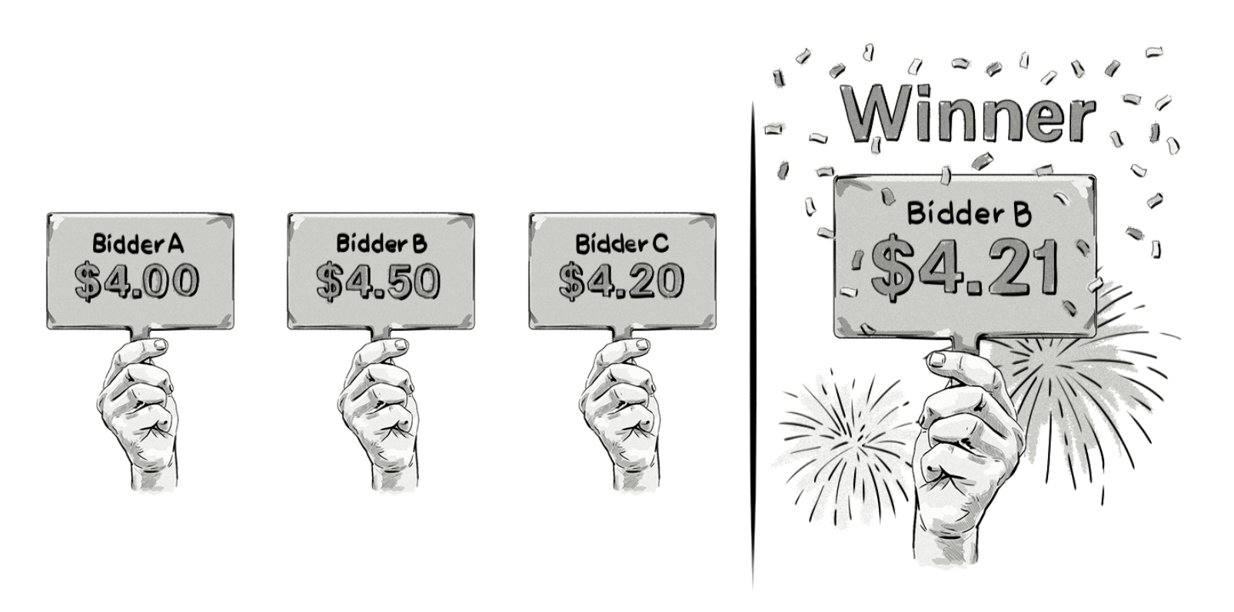
Second-Price Auction
Definition: The highest bidder wins and pays a price equal to the second-highest bid.
Notes:
第二价格策略的定义也很简单：赢家需要支付第二高的价格。这也是一个简单的例子。

Slide 27
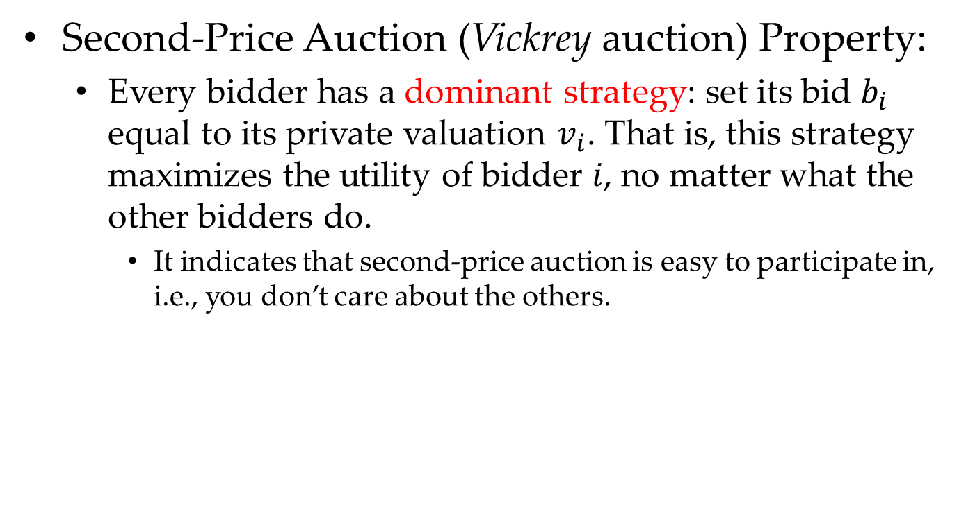
Second-Price Auction
Second-Price Auction (Vickrey auction) Property:
Every bidder has a dominant strategy: set its bid $b_{i}$ equal to its private valuation $v_{i}$. That is, this strategy maximizes the utility of bidder $i$, no matter what the other bidders do.
It indicates that second-price auction is easy to participate in, i.e., you don’t care about the others.

Slide 28
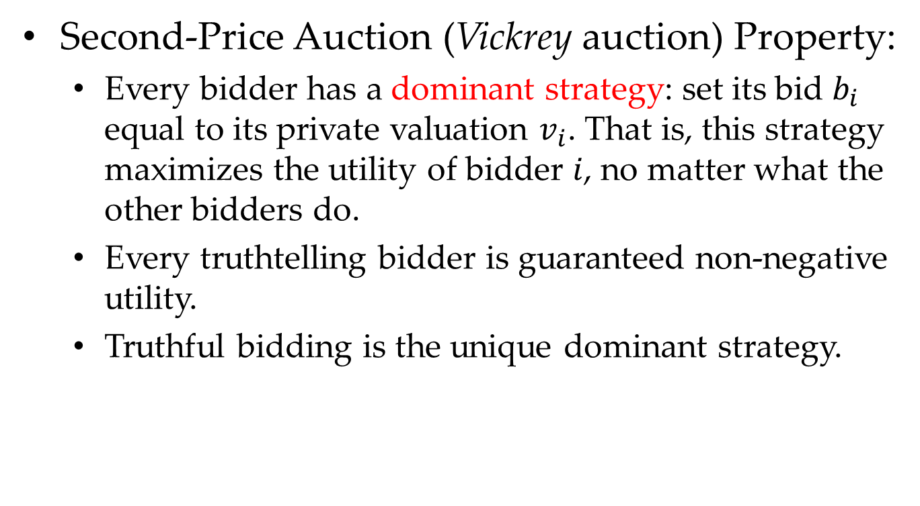
Second-Price Auction
Second-Price Auction (Vickrey auction) Property:
Every bidder has a dominant strategy: set its bid $b_{i}$ equal to its private valuation $v_{i}$. That is, this strategy maximizes the utility of bidder $i$, no matter what the other bidders do.
Every truthtelling bidder is guaranteed non-negative utility.
Truthful bidding is the unique dominant strategy.

Slide 29
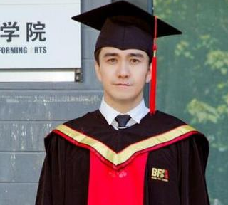
What is Dominant Strategy?
Dominant Strategy: 优势策略
表示某个策略一定优于其它策略，无论对手采取何种策略

Slide 30
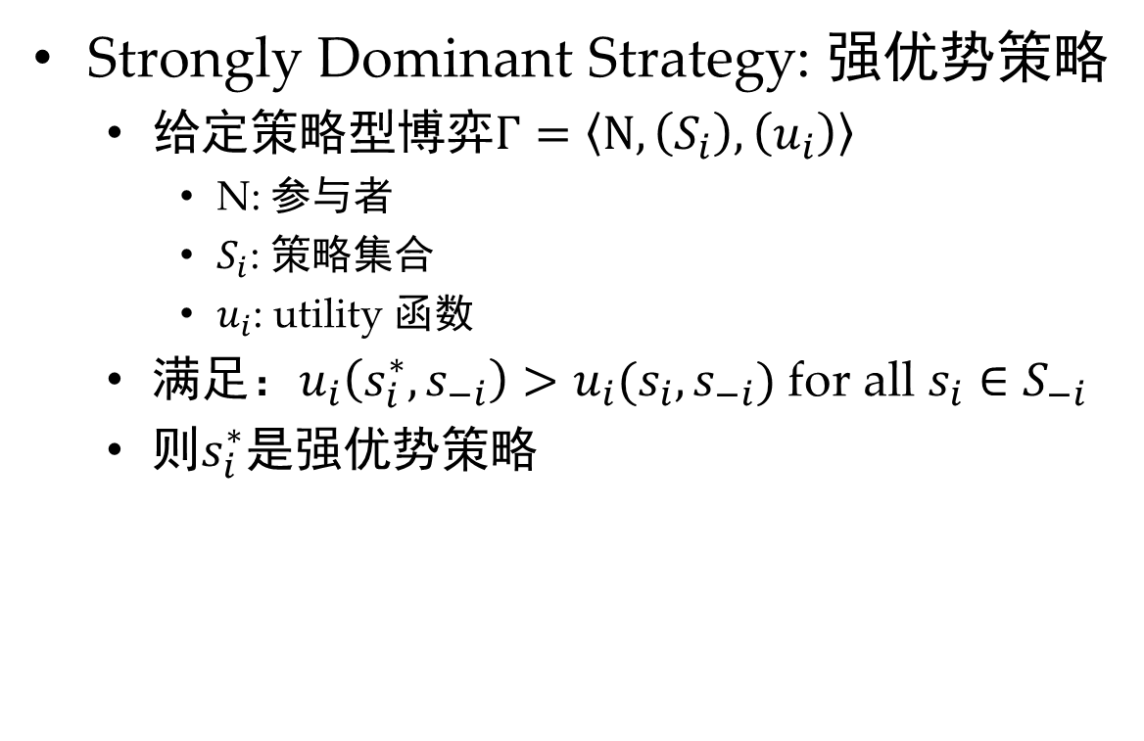
What is Dominant Strategy?
Strongly Dominant Strategy: 强优势策略
给定策略型博弈$Γ=\left\langle N,\left(S_{i}\right),\left(u_{i}\right)\right\rangle$
N: 参与者
$S_{i}$: 策略集合
$u_{i}$: utility 函数
满足：$u_{i}\left(s_{i}^{∗},s_{−i}\right)>u_{i}(s_{i},s_{−i})$ for all $s_{i}∈S_{−i}$
则$s_{i}^{∗}$是强优势策略

Slide 31
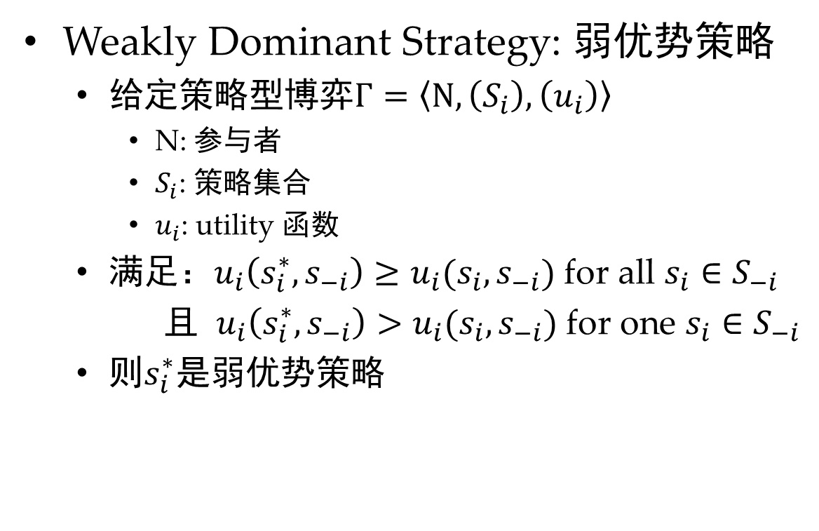
What is Dominant Strategy?
Weakly Dominant Strategy: 弱优势策略
给定策略型博弈$Γ=\left\langle N,\left(S_{i}\right),\left(u_{i}\right)\right\rangle$
N: 参与者
$S_{i}$: 策略集合
$u_{i}$: utility 函数
满足：$u_{i}\left(s_{i}^{∗},s_{−i}\right)≥u_{i}(s_{i},s_{−i})$ for all $s_{i}∈S_{−i}$
且 $u_{i}\left(s_{i}^{∗},s_{−i}\right)>u_{i}(s_{i},s_{−i})$ for one $s_{i}∈S_{−i}$
则$s_{i}^{∗}$是弱优势策略

Slide 32
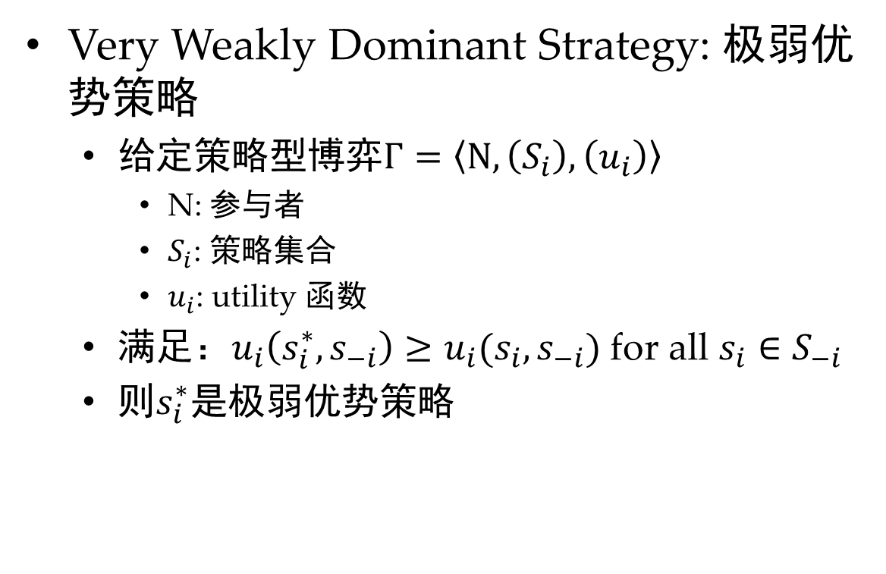
What is Dominant Strategy?
Very Weakly Dominant Strategy: 极弱优势策略
给定策略型博弈$Γ=\left\langle N,\left(S_{i}\right),\left(u_{i}\right)\right\rangle$
N: 参与者
$S_{i}$: 策略集合
$u_{i}$: utility 函数
满足：$u_{i}\left(s_{i}^{∗},s_{−i}\right)≥u_{i}(s_{i},s_{−i})$ for all $s_{i}∈S_{−i}$
则$s_{i}^{∗}$是极弱优势策略

Slide 33
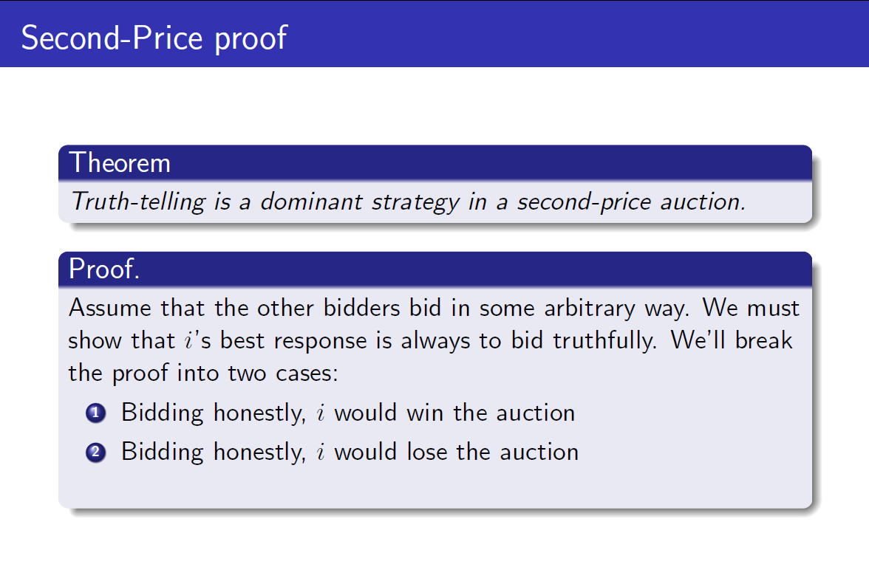
Second-Price Auction
Proof (of dominant strategy):
Notes:
问题一：如何证明是DS，
问题二：是哪种DS

Slide 34
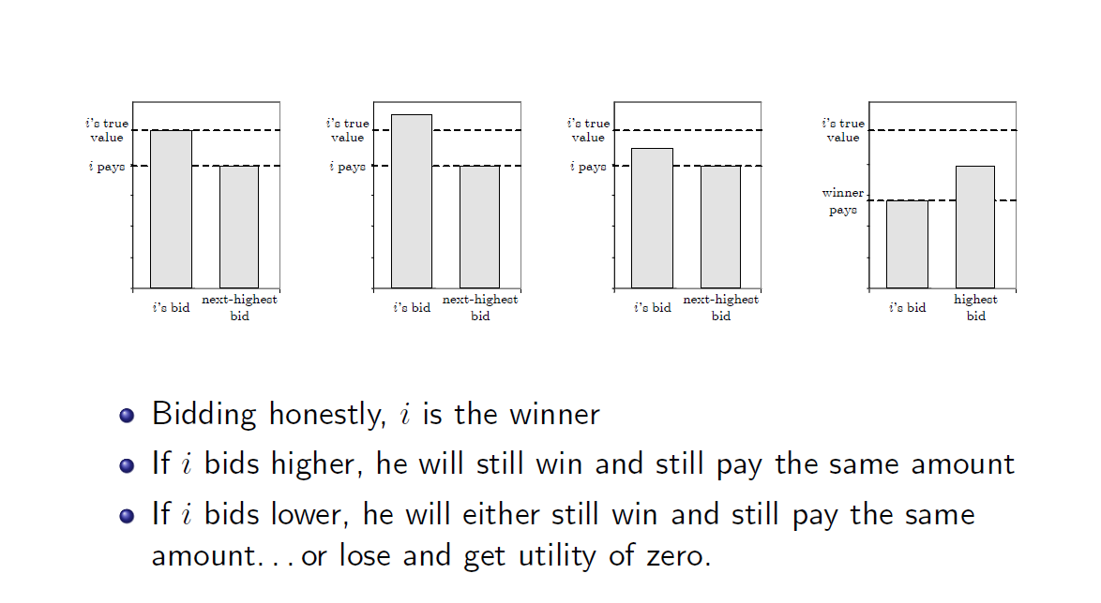
Case 1

Slide 35
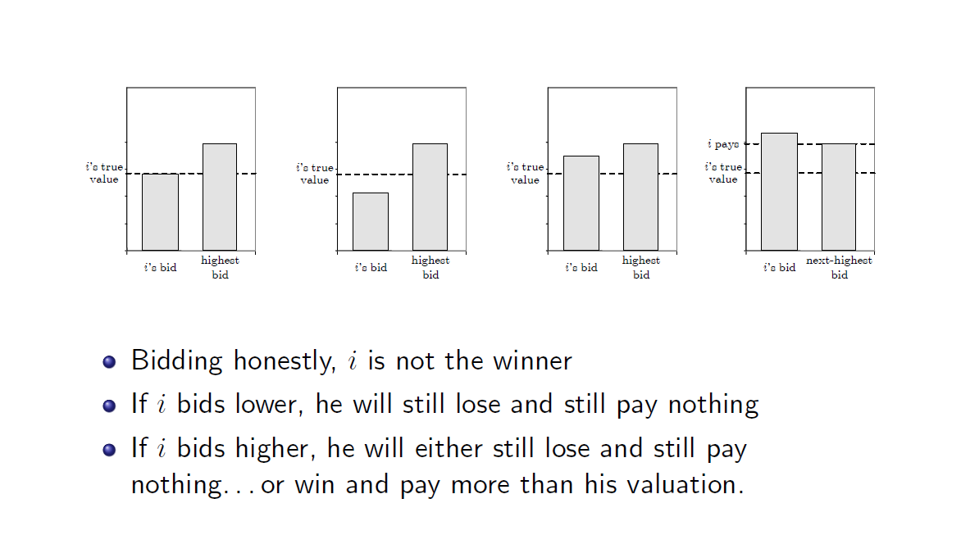
Case 2

Slide 36
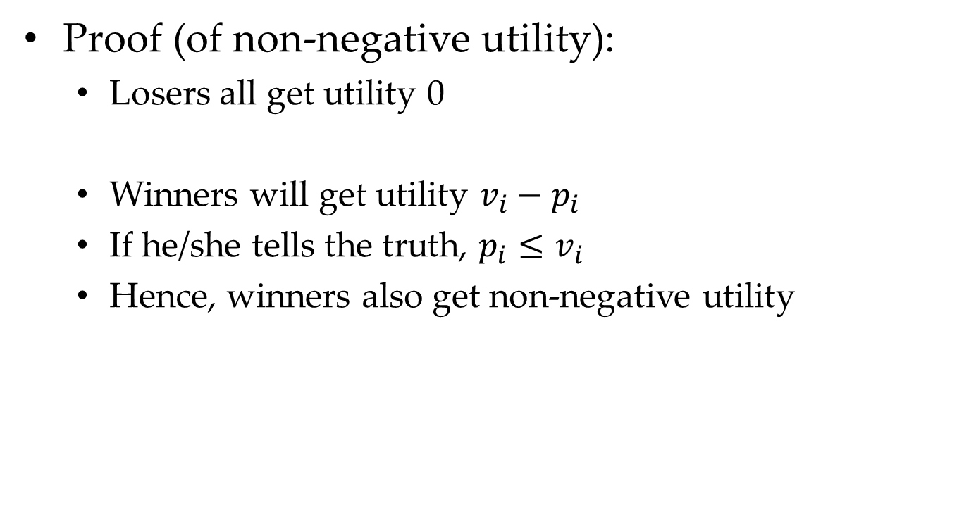
Second-Price Auction
Proof (of non-negative utility):
Losers all get utility 0
Winners will get utility $v_{i}−p_{i}$
If he/she tells the truth, $p_{i}≤v_{i}$
Hence, winners also get non-negative utility

Slide 37
Second-Price Auction
Proof (of unique dominant strategy):
Exercise

Slide 38
Second-Price Auction
Applications: Google’s AdWords
In 2002, Google first applies the second-price auction in the sponsored search.
Applications: eBay’s Auction
if you win an eBay auction, the sale price equals the highest other bid (the second highest overall), plus a small increment

Slide 39
Awesome Auctions

Slide 40
Awesome Auction
Vickrey auction is awesome with properties:
Strong incentive guarantees: dominant-strategy incentive-compatible (DSIC):
dominant strategy
truthful telling can guarantee non-negative utility

Slide 41
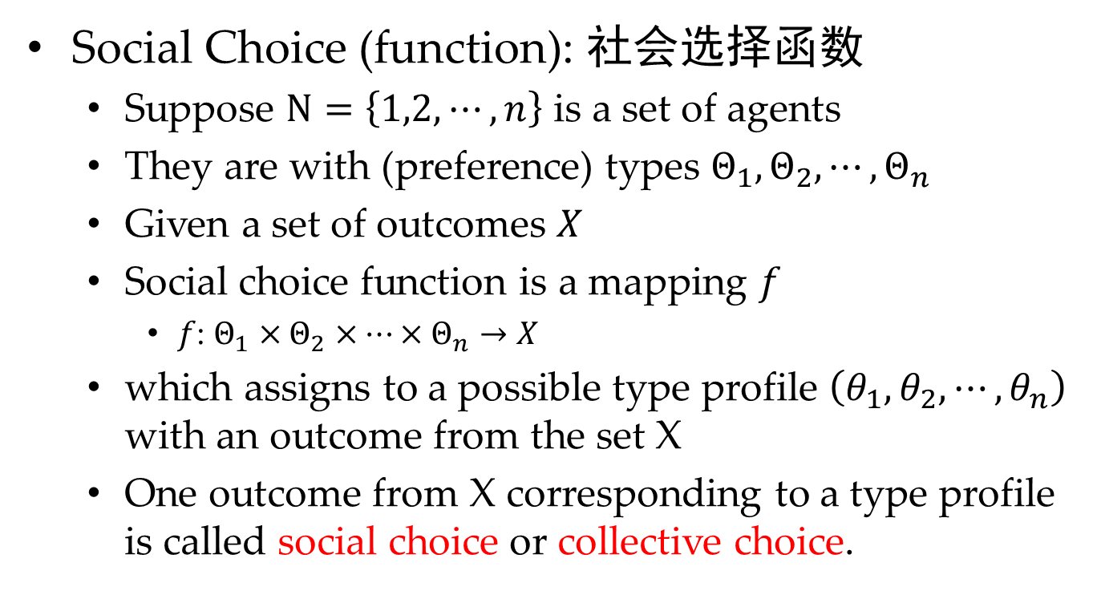
What is Social Choice?
Social Choice (function): 社会选择函数
Suppose $N=\left\{1,2,⋯,n\right\}$ is a set of agents
They are with (preference) types $Θ_{1},Θ_{2},⋯,Θ_{n}$
Given a set of outcomes $X$
Social choice function is a mapping $f$
$f$: $Θ_{1}×Θ_{2}×⋯×Θ_{n}→X$
which assigns to a possible type profile $\left(θ_{1},θ_{2},⋯,θ_{n}\right)$ with an outcome from the set X
One outcome from X corresponding to a type profile is called social choice or collective choice.

Slide 42
What is Incentive Compatible?
Incentive Compatible, IC: 激励相容
essentially refers to offering the right incentives that make agents reveal their types truthfully
There are broadly two types of incentive compatibility
(1) Truth telling is a best response for each agent no matter what is the choices of other agents;
(2) Truth revelation is a best response for each agent in expectation of the choices of other agents.
The first is called Dominant Strategy IC, DSIC
The second is called Bayesian Nash IC, BIC

Slide 43
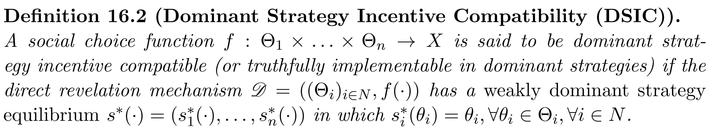
What is DSIC?
Dominant Strategy Incentive-Compatible: 优势策略激励相容
Properties:
strategy-proof: 防策略的
cheat-proof: 防欺诈的
straightforward: 坦率的
truthful: 如实的

Slide 44
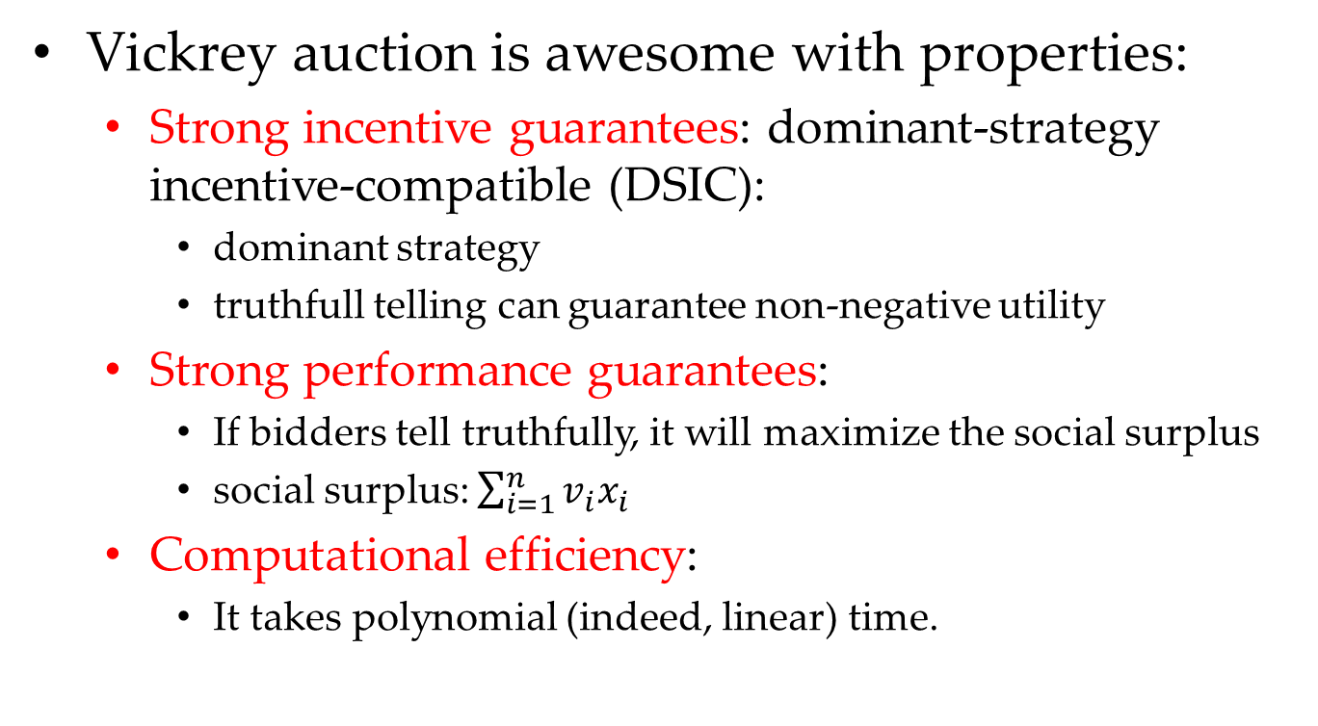
Awesome Auction
Vickrey auction is awesome with properties:
Strong incentive guarantees: dominant-strategy incentive-compatible (DSIC):
dominant strategy
truthfull telling can guarantee non-negative utility
Strong performance guarantees:
If bidders tell truthfully, it will maximize the social surplus
social surplus: $\sum_{i=1}^{n}{v_{i}x_{i}}$
Computational efficiency:
It takes polynomial (indeed, linear) time.

Slide 45
Practical Meaning
From a bidder’s perspective
DSIC: guarantees that trutful telling is DS, makes it easy to choose a bid (i.e., just telling the truth)
From a auctioneer’s perspective
DSIC: makes it easy to predict the auction’s outcome
Surplus-maximization: makes it possible to identify the highest valuation without any prior knowledge

Slide 46
Case Study: Sponsored Search Auctions

Slide 47
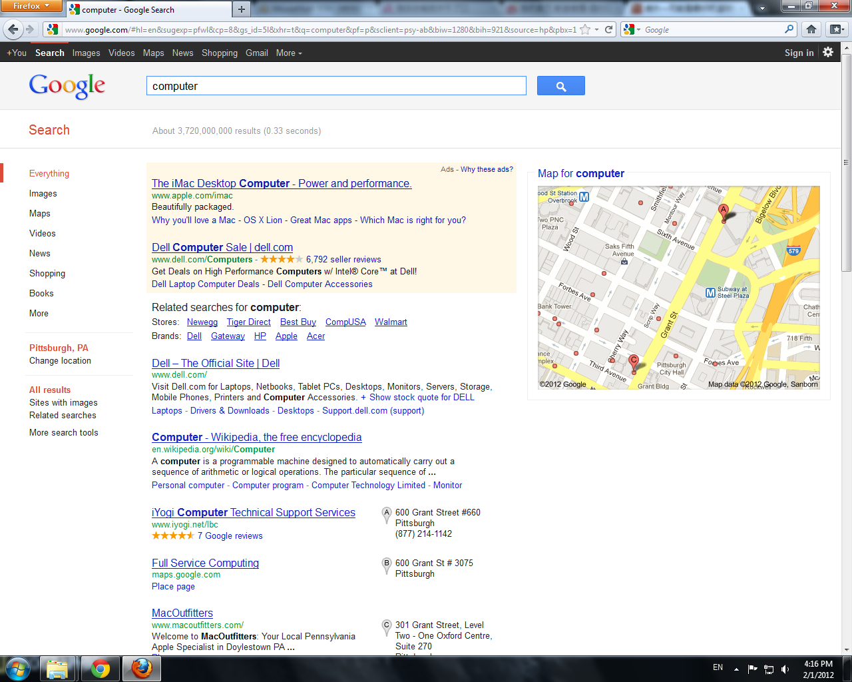
Sponsored Search Auctions: Background

Slide 48
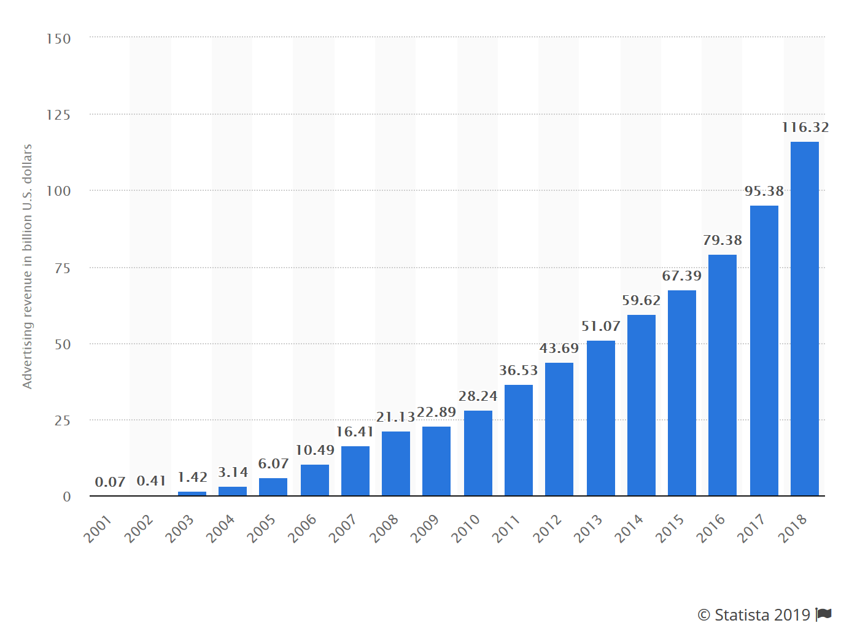
Sponsored Search Auctions: Background
2001~2018年谷歌广告的收入（单位：十亿美元）
In 2006, 98% of Google’s revenue comes from sponsored search.

Slide 49
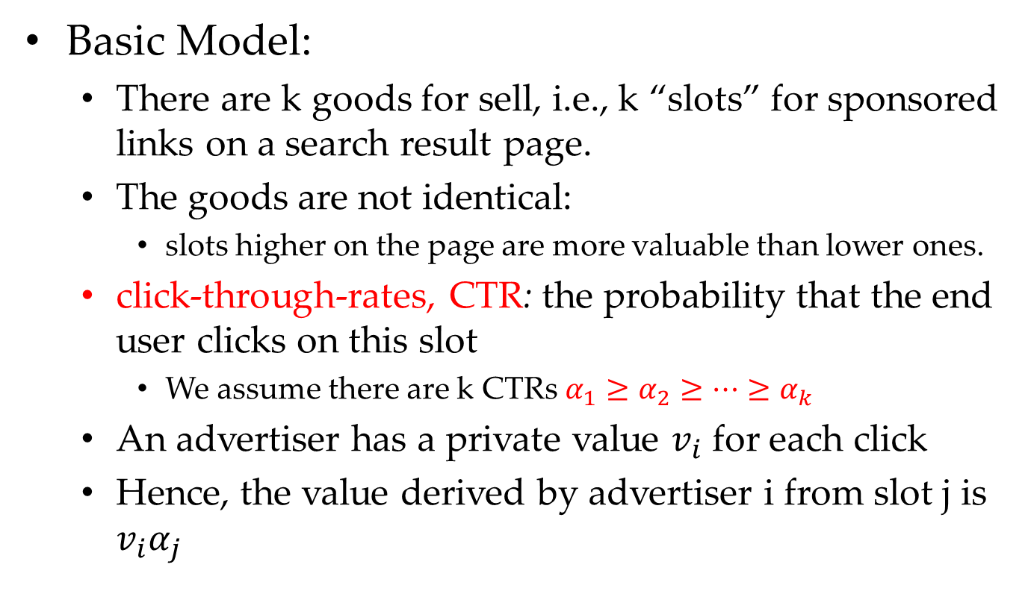
Sponsored Search Auctions: Background
Basic Model:
There are k goods for sell, i.e., k “slots” for sponsored links on a search result page.
The goods are not identical:
slots higher on the page are more valuable than lower ones.
click-through-rates, CTR: the probability that the end user clicks on this slot
We assume there are k CTRs $α_{1}≥α_{2}≥⋯≥α_{k}$
An advertiser has a private value $v_{i}$ for each click
Hence, the value derived by advertiser i from slot j is $v_{i}α_{j}$

Slide 50
Sponsored Search Auctions: What We Want
DSIC: truthful telling is a dominant strategy, and leads to non-negative utility.
Social-surplus Maximization: the mechanism would maximize the outcome of auctioneer.
Computational Efficiency: the mechanism should be terminated in polynomial time.

Slide 51
Sponsored Search Auctions: Our Design Approach
Challenge:
the choice of who wins what
the choice of who pays what
Basic Idea:
Step 1: Assume bidders are truthful, how to assign bidders to slots such that property (2) and (3) hold?
Step 2: Given answer in Step 1, how should we set selling prices such that property (1) holds?

Slide 52
Sponsored Search Auctions: Our Design Approach
Natural Idea of Step 1:
Greedy: Assign the j-th highest bidder to the j-th highest slot
Natural Idea of Step 2:
Second-Price Auction: will be elaborated in the next lecture, Myerson’s Lemma

Slide 53
Summary

Slide 54
Summary
Many Auctions
Single-item Auction
Sealed-Bid Auction
First-Price Auction v.s. Second-Price Auction

Slide 55
Summary
Many Economic Properities:
Quasi-linear
Truthfulness
Dominant Strategy (优势策略)
Incentive Compatible, IC (激励相容)
Dominant Strategy Incentive Compatible, DSIC (优势策略激励相容)
Surplus Maximization (社会剩余最大化)
Computational Efficiency (多项式时间可计算)

Slide 56
Exercises
Tim Exercises:
Lecture 1: #3
Lecture 2: #4 ~ #8
Additional Exercises:
Prove truthful telling is unique dominant strategy in second-price auction.
Prove Greedy can maximize social-surplus in step 1 of sponsored search.
Find the dominant strategy of Japanese and English Auction.

Slide 57
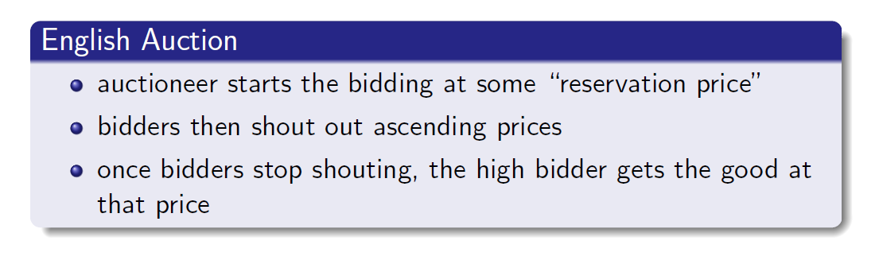
English Auction

Slide 58
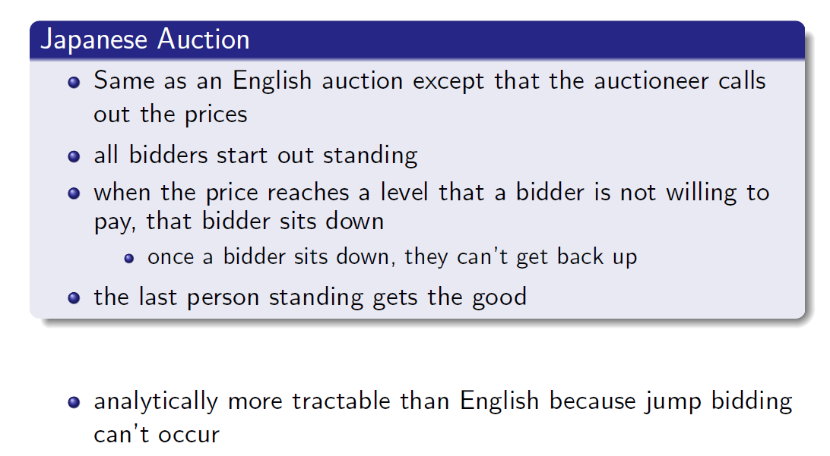
Japanese Auction

Slide 59
Thanks
Any Questions ???

